Slide 1
ECEN 5823 Spring 2024
University of Colorado, Boulder
IoT Embedded Firmware : Course Project Proof-of-Concept Demonstration
Team 8: Krishna Suhagiya

Slide 2
Overview
Option 1
Smart Light Monitoring
A BLE-based system using a SiLabs BlueGecko board with an ADC based ambient light sensor and button.
Implements two encrypted GATT services and uses numerical pairing for secure communication.
The button is used for passkey confirmation and basic interaction.

Slide 3
Requirements
The product shall measure ambient light levels using the TEMT 6000 ambient light sensor.
The product shall broadcast BLE advertisement packets periodically.
The product shall allow the Si Connect app to establish a secure connection using BLE numerical pairing.
The product shall expose a custom GATT service with a characteristic that notifies the client with light level percentage.
The product shall display current light levels and button state on an onboard LCD.
The product shall operate in EM2 (Energy Mode 2) for low-power operation when idle.

Slide 4
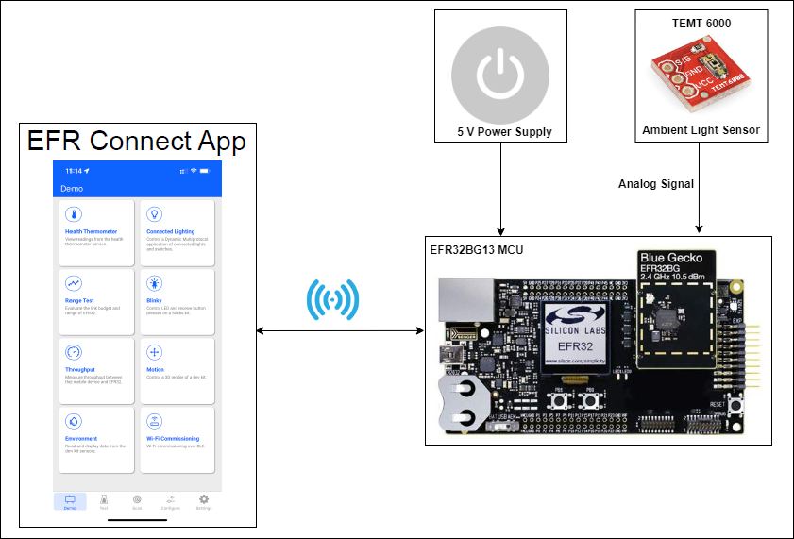
Hardware Block Diagram

Slide 5
Hardware Block Diagram
Key Components
Ambient Light Sensor (Manufacturer Part Number: TEMT6000)
Senses ambient light intensity
Analog phototransistor; outputs voltage proportional to light level
SiLabs BlueGecko (EFR32BG22)
Core controller with BLE support
Reads analog light levels, manages BLE GATT services, and handles security
Used for passkey confirmation during numerical pairing
Button (GPIO Input)
Supports basic user interactions

Slide 6
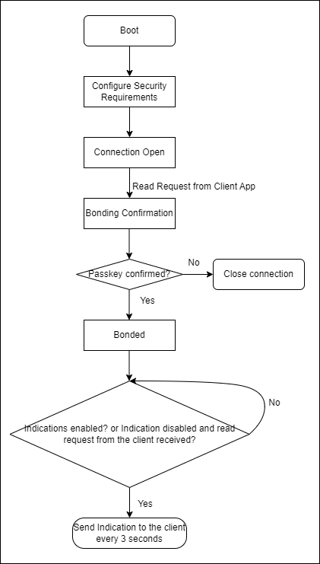
Software
GATT Services
GATT Service Name | Characteristic ID | Length (Bytes) | Characteristic UUID
ECEN5823 Light Level Test | light_level_percentage | 1 | 00000004-058f-49af-b3f8-5d8b4f7f885f
ECEN5823 Encryption Test | button_state | 1 | 00000002-38c8-433e-87ec-652a2d136289
Flow Chart

Slide 7
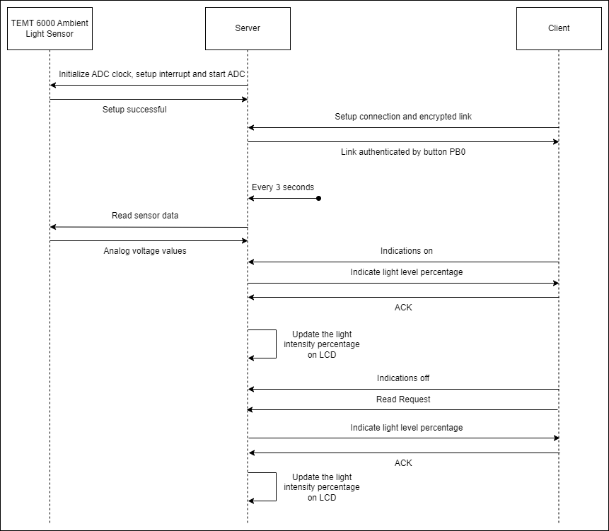
Software
Data Types
Measurement | Units | Data Type | Valid Range | Update Rate
Light Level | Percentage | Uint8_t | 0 to 100 | 0.33 Hz
Button State | None | Uint8_t | 0 or 1 | On user action
ADC Configuration
Mode: Single-shot (one conversion per trigger)
Resolution: 12-bit (0–4095 steps)
Reference: Internal 2.5V (adcRef2V5)
Input Channel: adcPosSelAPORT2XCH9 (connected to TEMT6000)
ADC Clock: 13 MHz
Trigger: Software-controlled every 3 seconds
Output: ADC result → millivolts:(sample × 2500) / 4096
percentage = (uint8_t)((millivolts / 2500.0) × 100.0)
Data Flow

Slide 8
Challenges
Mapping the raw analog voltage from the TEMT6000 to a consistent 0–100% light level required calibration and testing under different lighting conditions to ensure meaningful readings.

Slide 9
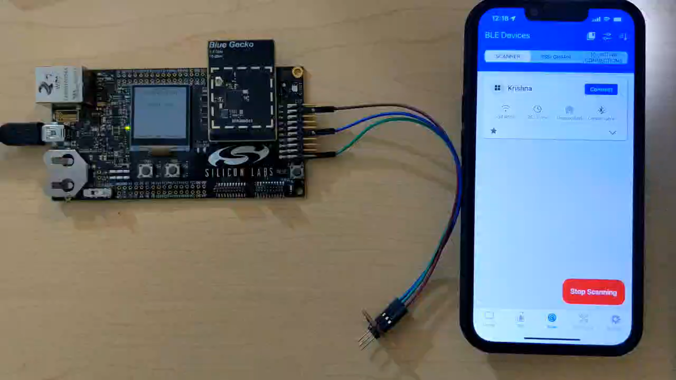
Demonstration

Slide 10
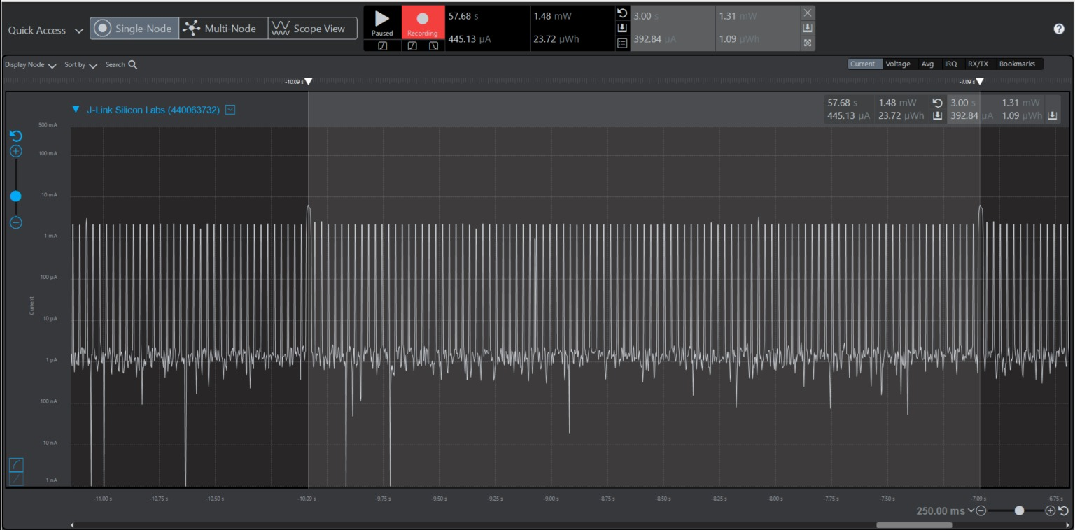
Energy Profiler Screenshot

Slide 11
Q&A

